Slide 1

Mole Detection
Mahboubeh Faghih
Junior Data Scientist @Becode

Slide 2
CONTENTS OF THIS Project
The purpose of this project is to create a tool that considering the image of a mole, can calculate the probability that a mole can be malign.
Pre-processing
CNN Model
Model Evaluation : Testing and validation accuracy, confusion matrix
Results presentation : Web App

Slide 3

01 Pre-processing
Data Cleaning
Loading and resizing of images
EDA
Splitting Data

Slide 4
detect 7 different classes of skin cancer using Convolution Neural Network with keras tensorflow:
7 different classes of skin cancer
Melanocytic nevi
Melanoma
Benign keratosis-like lesions
Basal cell carcinoma
Actinic keratoses
Vascular lesions
Dermatofibroma

Slide 5
Data Cleaning
In this step we check for Missing values. we will fill the null values by their mean.

Slide 6
Loading and resizing of images
We resize the images as the original dimension of images are
450 x 600 x3 which TensorFlow can't handle, so that's why
we resize it into 100 x 75.

Slide 7
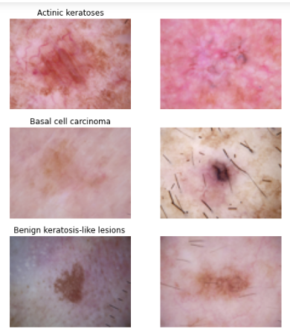
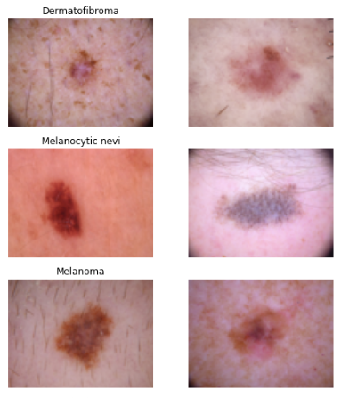
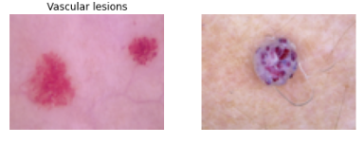

Slide 8
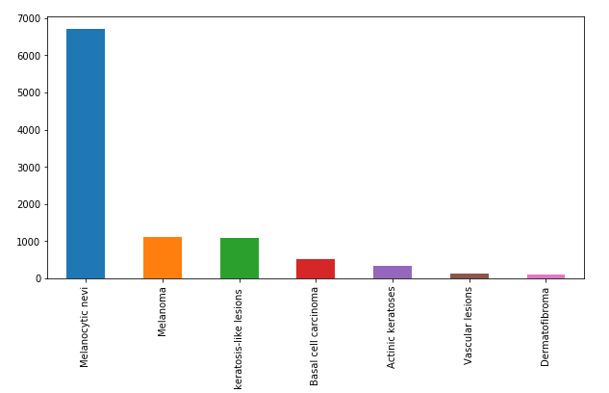
EDA
see distribution of 7 different classes of cell type.

Slide 9
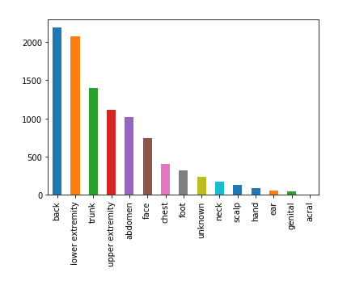
Plotting the distribution of localization field

Slide 10
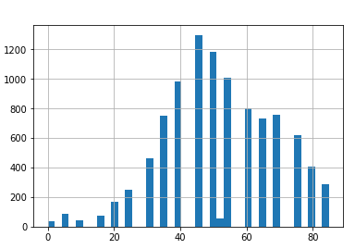
check the distribution of Age

Slide 11
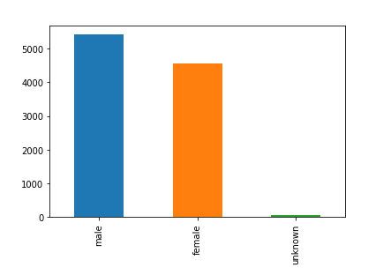
Plot the distribution of males and females

Slide 12
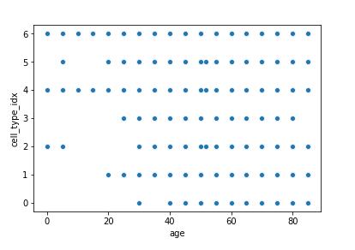
visualize agewise distribution of skin cancer types
It seems that skin cancer types 0,1, 3 and 5 which are Melanocytic nevi, dermatofibroma,
Basal cell carcinoma and Vascular lesions
are not much prevalent below the age of 20 years.

Slide 13
Splitting Data
Train Test Split
Normalization
Splitting training and validation split
In this step we have splitted the dataset into training and testing set of 80:20 ratio.
I choosed to normalize the x_train, x_test by subtracting from their mean values and then dividing by their standard deviation.
I choosed to split the train set in two parts : a small fraction (10%) became the validation set which the model is evaluated and the rest (90%) is used to train the model.

Slide 14
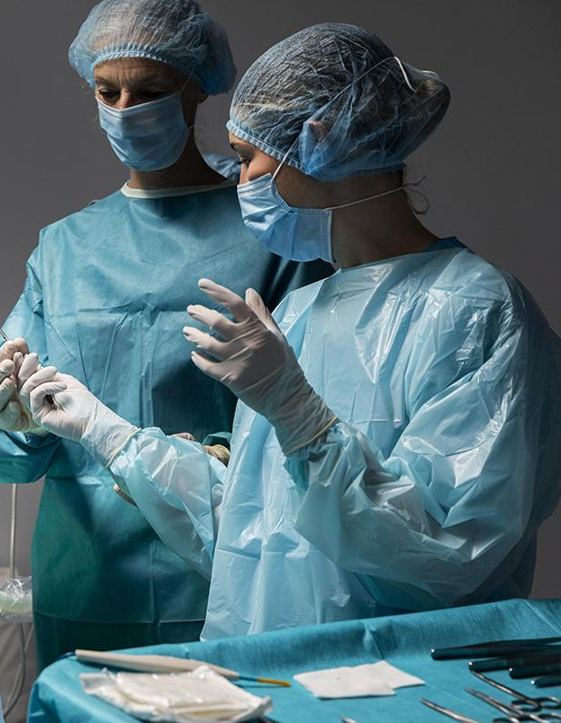
02 CNN Model
Model Building
Setting Optimizer
Data Augmentation
Fitting the model

Slide 15
Model Building
I used the Keras Sequential API.
The first is the convolutional (Conv2D) layer.
The second important layer in CNN is the pooling (MaxPool2D) layer.
Dropout is a regularization method.
This flattening step is needed so that you can make use of fully connected layers after some convolutional/maxpool layers.
In the end i used the features in two fully-connected (Dense) layers.

Slide 16
Setting Optimizer
Once our layers are added to the model, we need to set up a score function, a loss function and an optimisation algorithm.

Slide 17
Data Augmentation
In order to avoid overfitting problem, we need to expand artificially our dataset.

Slide 18
Fitting the model
In this step finally I fit the model into x_train, y_train.
In this step I have chosen 100 batch size
and I have chosen 20 epochs to give the model sufficient epochs to train.

Slide 19

03 Model Evaluation
In this step we will check the testing accuracy and validation accuracy of our model, plot confusion matrix.

Slide 20

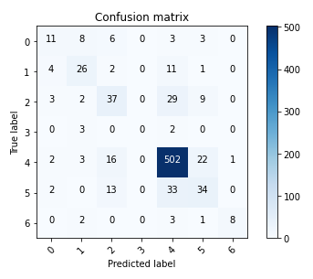

Slide 21
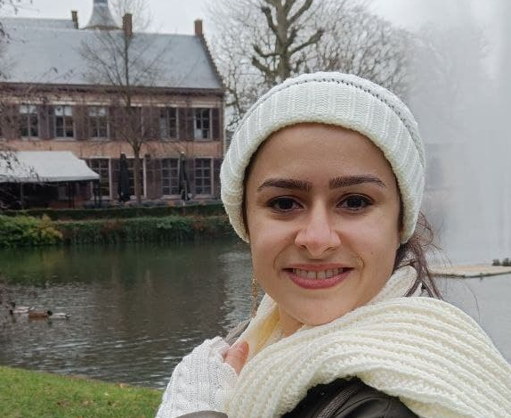
Thanks
MAHBOUBEH FAGHIH
Do you have any questions?
linkedin.com/in/mahboubeh-faghih-mohammadi

